Slide 1

Understanding BAIIR: The Data Analysis Framework
BAIIR guides your analysis from baseline to recommendation
It ensures clear, actionable insights for decision-makers.
SW
Notes:
1

Slide 2
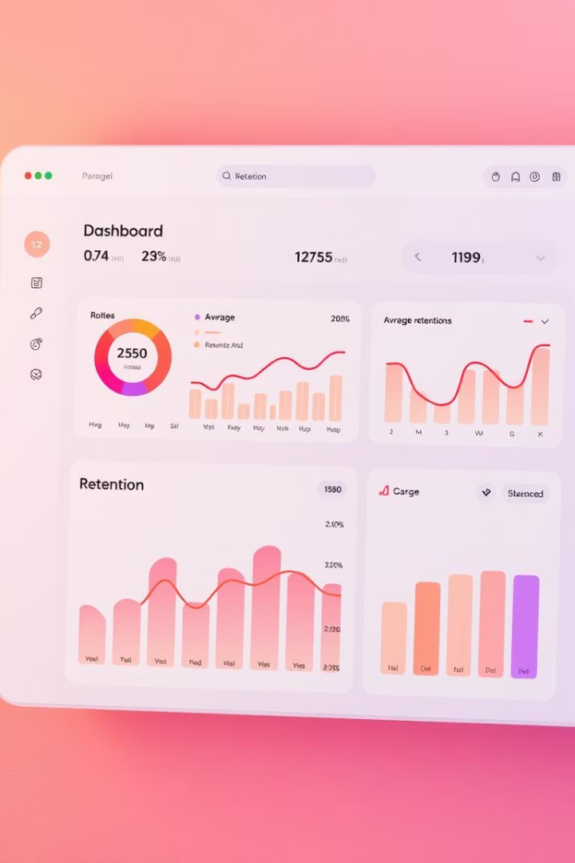
B: Baseline - Establishing the Starting Point
Definition
Purpose
Understand conditions before changes or launches
Identify the normal state to compare against future data
Examples
Average user retention
System load levels
Support ticket volume
Notes:
2

Slide 3
A: Analysis -
Examining the Data
Core Actions
Identify Trends
Compare groups or periods
Spot spikes or drops
Analyze user actions
Detect repeatable patterns
Review performance and support data
Understand shifts over time
Notes:
3

Slide 4

I: Insights -
Discovering Meaning in Data
Behavior Patterns
Performance Issues
Feature adopters showing longer retention
Errors increased after new releases
Purpose
Explain the reasons behind data changes
Notes:
4

Slide 5

I: Impact
What the Data Means for Business
Link Insights to Outcomes
Explain how trends affect user experience or revenue.
Examples
Performance bottlenecks reduce satisfaction.
Feature engagement boosts retention.
Decision Support
Provide context to guide business strategies.
Notes:
5

Slide 6




R: Recommendation - Data-Backed Next Steps
Promote Key Features
Focus marketing on high-retention tools.
Fix Performance Issues
Address bottlenecks to improve experience.
Justify Actions
Use quantitative data to support decisions.
Notes:
6

Slide 7





BAIIR Overview: Framework Summary
Analysis
2
Break data into meaningful segments
Baseline
Know the starting conditions.
1
3
Insights
Find hidden stories behind numbers
5
Recommendation
Suggest clear, actionable steps.
4
Impact
Link findings to business results
Notes:
7

